Slide 1





LANDSCAPE INFLUENCE ON THE PERSISTENCE OF TERRESTRIAL MAMMALS IN ATLANTIC FOREST FRAGMENTS
GABRIELLE BECA
gabrielle.beca@gmail.com
PPG Ecologia e Biodiversidade – UNESP Rio Claro
Mauro Galetti . Milton Ribeiro . Carlos Peres

Slide 2
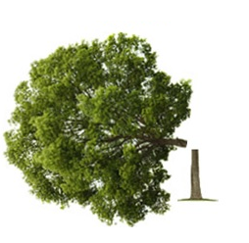

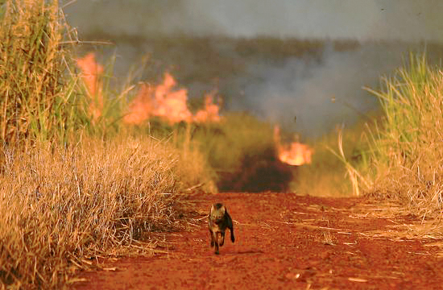
Introduction
⇨ fragmentation and habitat loss –major threats to biodiversity;
agricultural ecosystems – 80% of global deforestation;
53% of terrestrial species
are assessed as threatened;
Metzger, 2000; Tscharntke et al. 2005; Kissinger et al. 2012; IUCN, 2014

Slide 3
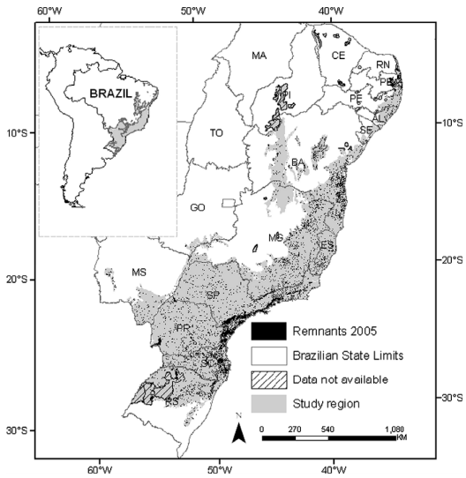
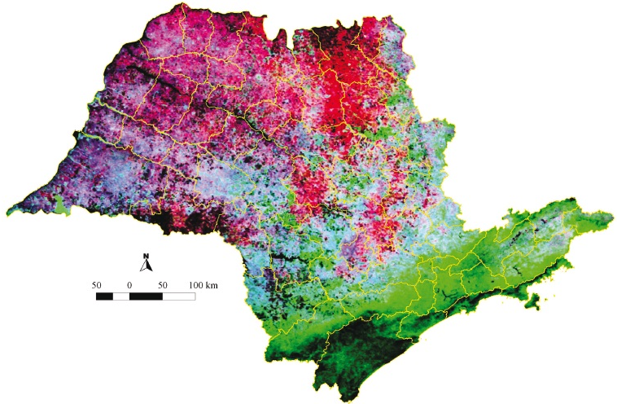

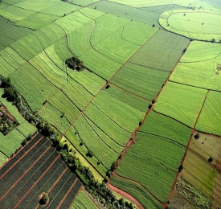
Introduction
remnants of native forest – embedded in matrices of sugarcane and pasture;
 permeability;
 amount of edge;
Ribeiro et al. 2009; Tabarelli et al. 2004; Manzatto, 2005; Galetti & Sazima, 2006; Vicente et al. 2012

Slide 4
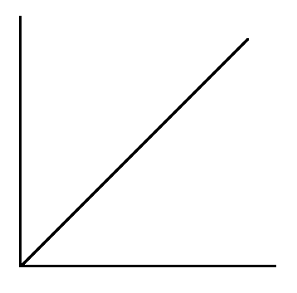

Objectives
what explains the richness and the composition of medium and large sized mammals in fragmented landscapes dominated by sugarcane plantations?
Mammals
Richness
Mammals
Richness
Habitat Amount
Edge Amount
Andrén, 1994; Pardini et al. 2010; Fahrig, 2013; Kremsater & Bunnell, 1999

Slide 5
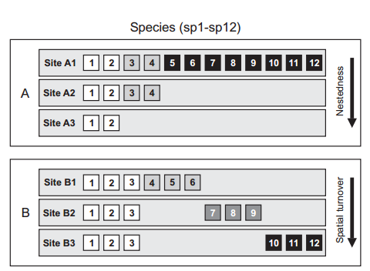
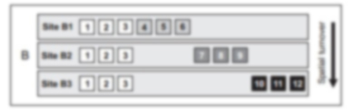
Objectives
what explains the richness and the composition of medium and large sized mammals in fragmented landscapes dominated by sugarcane plantations?
Baselga, 2010

Slide 7
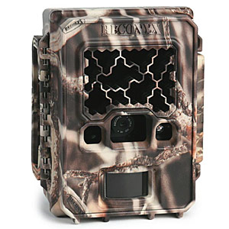
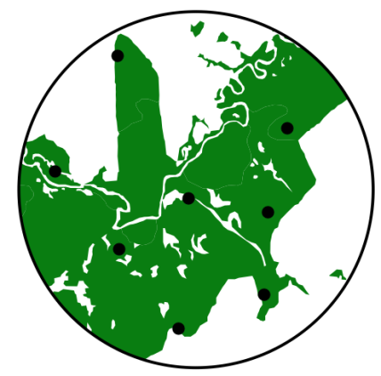
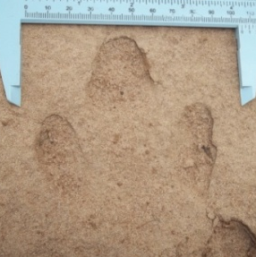
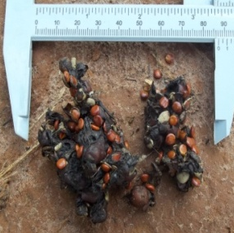
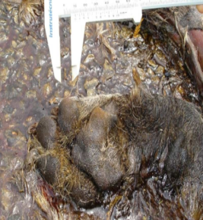
Mammals Sampling
8 camera trap;
30 days;
no baits;
jan/14 to feb/15 – may/15 to sep/15;
 sample points in a single type of patch;
sites with similar features;
200 m ~ 1500 m;
5760 hours/landscape;
55%
Benett et al. 2006

Slide 8
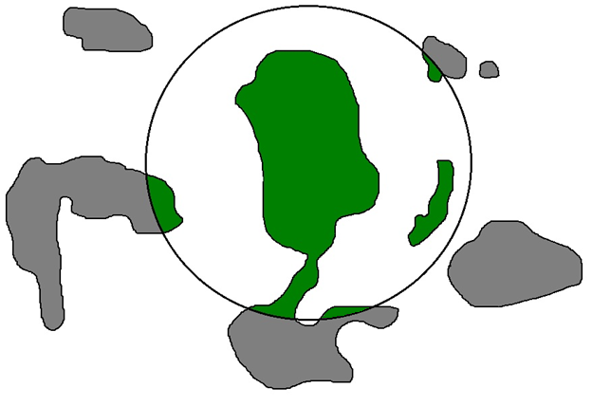
Landscape Variables
Forest Cover
2 km
Lyra-Jorge et al. 2010

Slide 9

Landscape Variables
Structural Area
2 km
10 km

Slide 10
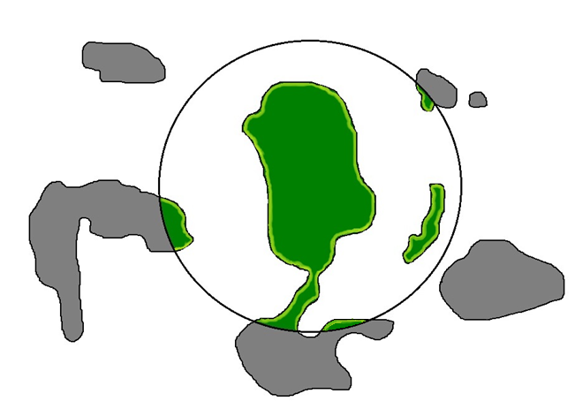
Landscape Variables
Edge Amount
2 km
edge = 1 pixel = 30 m
landsat 30 x 30 m

Slide 11
Data Analysis
Total Mammal Richness
⇨ accumulation curves;
⇨ first-order Jackknife estimator;
Partial Mammal Richness
terrestrial and forest dependents;

Slide 12
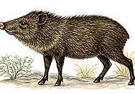
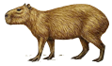
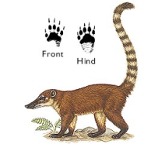
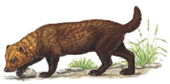
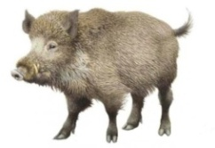
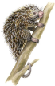
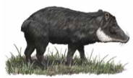
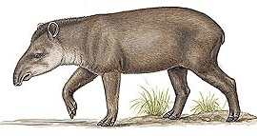
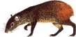
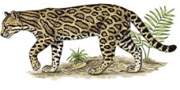
Data Analysis
terrestrial and forest dependents
Eisenberg & Redford, 1999; Emmons & Feer, 1997; Galetti et al. in prep

Slide 13
Data Analysis
Total Mammal Richness
⇨ accumulation curves;
⇨ first-order Jackknife estimator;
Partial Mammal Richness
terrestrial and forest dependents;
Mammal Composition
RDA: landscape variables  composition of medium and large sized mammals;

Slide 14
Data Analysis
Landscape Effects on Mammal Richness and Composition
GLM, Poisson family distribution – total and richness and terrestrial forest dependents;
GLM, Binomial family distribution – species occurrence;
MODELS
M0: DV ~ Null Model
M1: DV ~ Forest Cover
M2: DV ~ Strcutral Area
M3: DV ~ Edge Amount
ΔAICc<2.0 – wAICc>0.1
Zuur et al. 2009; Burnham & Anderson, 2010

Slide 15
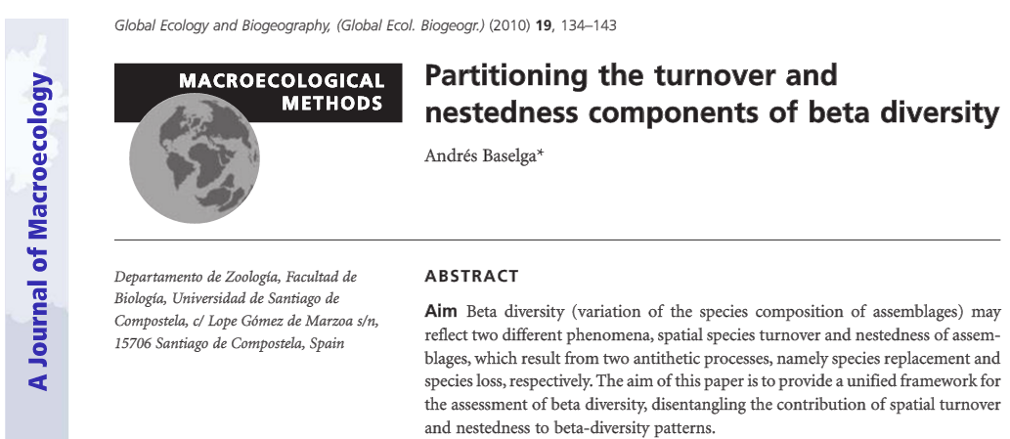
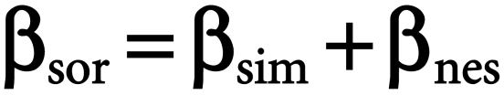

Data Analysis
Beta Diversity
nestedness
turnover
Baselga, 2010

Slide 16
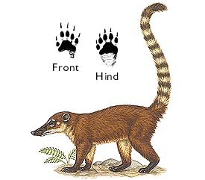
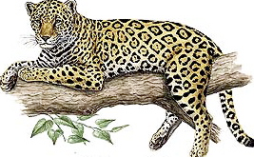
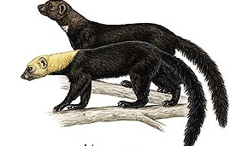
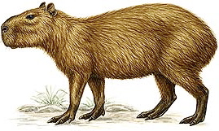
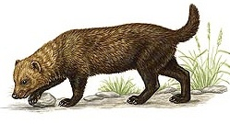
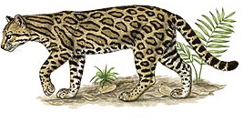
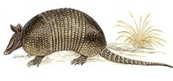
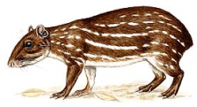
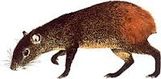
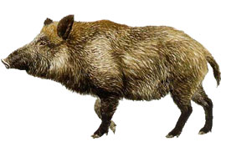

Data Analysis
Beta Diversity
⇨ TURNOVER
Baselga, 2010

Slide 17
Data Analysis
Beta Diversity
⇨ NESTEDNESS
Baselga, 2010

Slide 18
Data Analysis
Beta Diversity
⇨ turnover and nestedness;
null model (saving the rarity the frequency of occurrence of the species);
⇨ confidence intervals;
Baselga, 2010

Slide 19

Data Analysis
Beta Diversity
dissimilarity of landscape variables;
MRM – effect of landscape variables on the components of beta diversity;
%F.C
C01
C02
.
.
C20
C01 C02 . . C20
C01
C02
.
C20
%F.C
~ + +
F.C%
S.A
E.A
Lichstein, 2007

Slide 20
Results
⇨ total sampling effort: 115,200 h;
28 species recorded;
Total Mammal Richness
 12 species/landscape – between 7 to 17 species;
Terrestrial and Forest Dependents
 5 species/landscape – between 2 to 8 species;

Slide 21
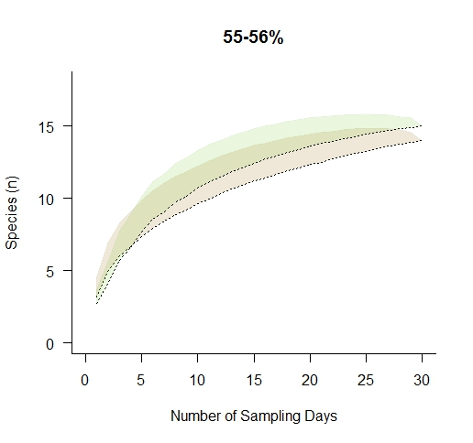


15 espécies
14 espécies

Slide 22
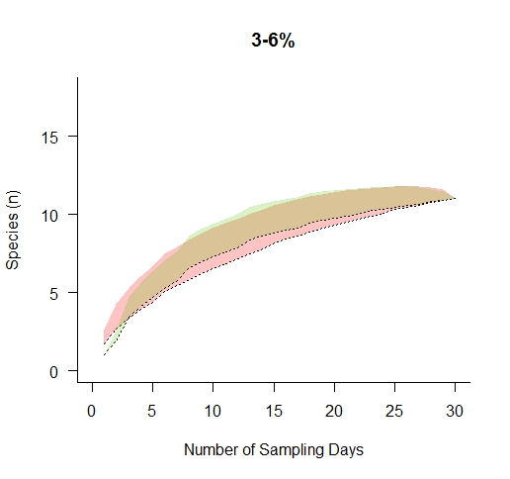
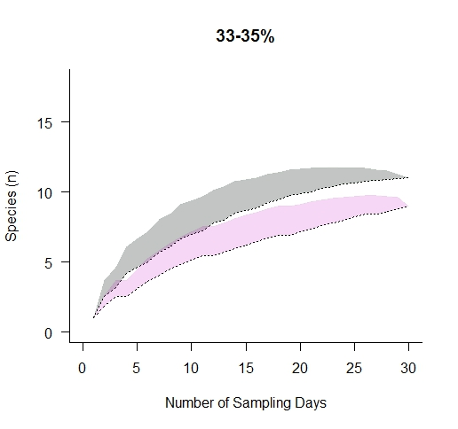
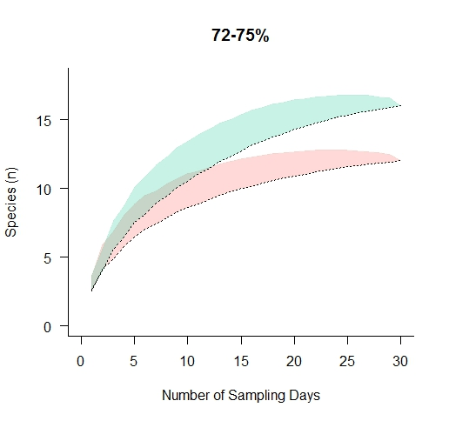
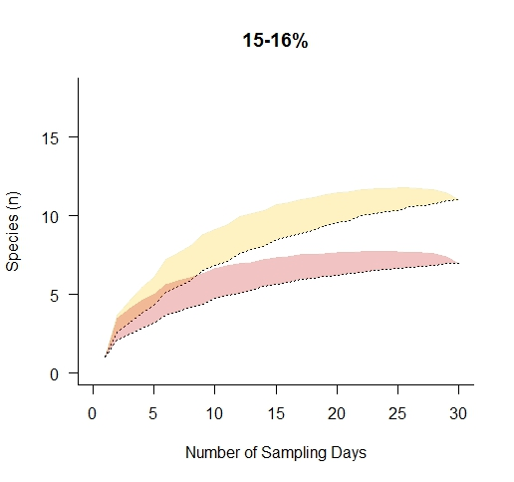
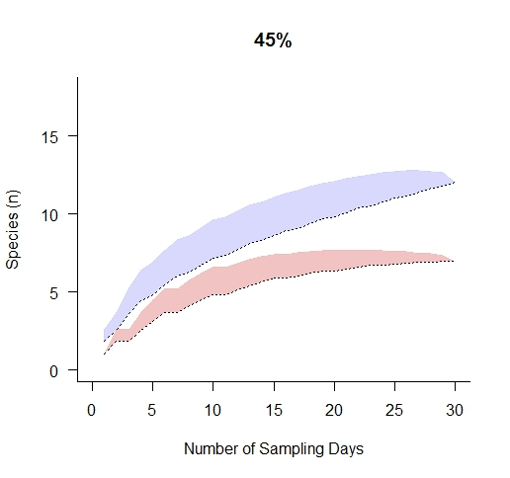
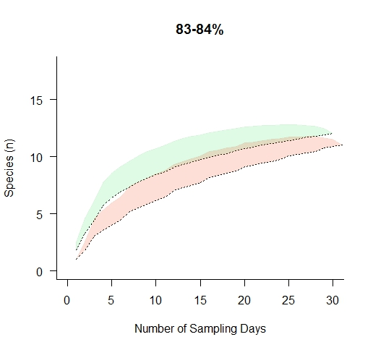
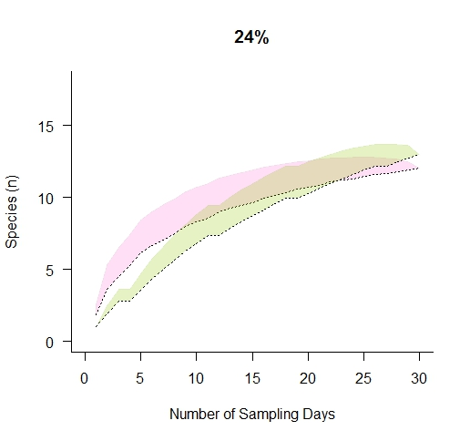
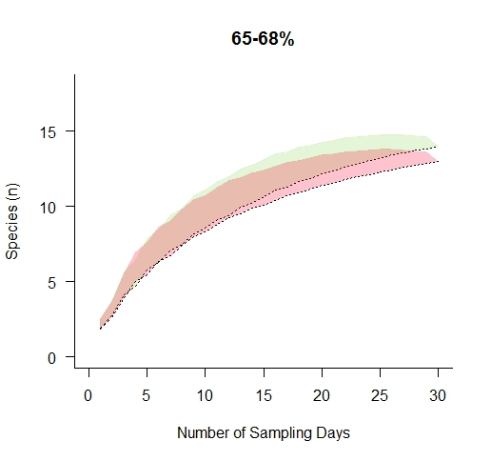
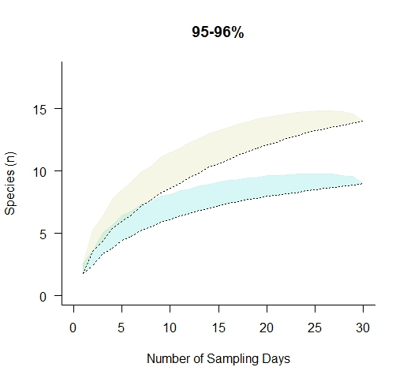

Slide 23
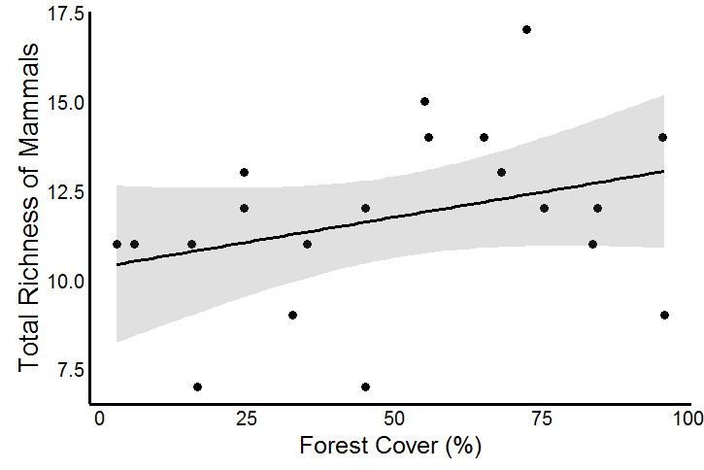
Results
Landscape Effects on Mammal Richness
Response Variable | Model | ΔAICc | df | wAICc
Total Richness
 | Null | 0.0 | 1 | 0.36
 | Forest Cover | 0.7 | 2 | 0.25
 | Structural Area | 0.8 | 2 | 0.24
 | Edge | 1.7 | 2 | 0.15
Mammals
Richness
Habitat Amount

Slide 24
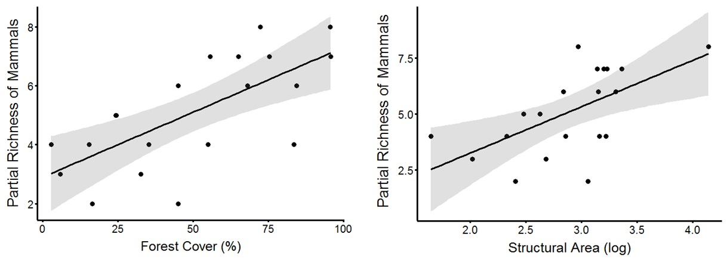
Results
Landscape Effects on Partial Mammal Richness
Response Variable | Model | ΔAICc | df | wAICc
Partial Richness
 | Forest Cover | 0.0 | 2 | 0.60
 | Structural Area | 1.6 | 2 | 0.27
 | Null | 3.9 | 1 | 0.08
 | Edge | 5.6 | 2 | 0.03

Slide 25
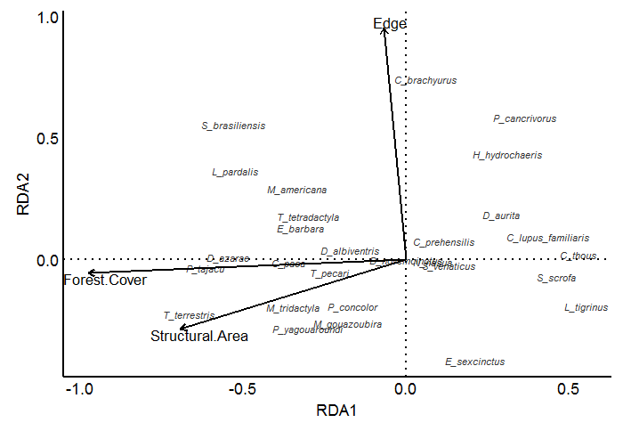






Results
Landscape Effects on Mammal Composition
R² = 0.19; p = 0.04

Slide 26
Results
Landscape Effects on Mammal Composition
Response Variable | Model | ΔAICc | df | wAICc
Tapirus terrestris
 | Forest Cover | 0 | 2 | 0.82
 | Structural Area | 3.4 | 2 | 0.15
 | Null | 8.1 | 1 | 0.01
 | Edge | 10.3 | 2 | 0.00
Pecari tajacu
 | Forest Cover | 0 | 2 | 0.71
 | Structural Area | 2.3 | 2 | 0.22
 | Null | 5.4 | 1 | 0.04
 | Edge Amount | 7.9 | 2 | 0.01

Slide 27
Results
Landscape Effects on Mammal Composition

Slide 28
Results
Landscape Effects on Mammal Composition
Response Variable | Model | ΔAICc | df | wAICc
Chrysocyon brachyurus
 | Edge | 0 | 2 | 0.90
 | Null | 5.5 | 1 | 0.05
 | Forest Cover (%) | 7.6 | 2 | 0.02
 | Structural Area | 7.9 | 2 | 0.01

Slide 29
Results
Landscape Effects on Mammal Composition

Slide 30
Results
LANDSCAPE EFFECTS ON MAMMALS COMPOSITION
Response Variable | Model | ΔAICc | df | wAICc
Myrmecophaga tridactyla
 | Structural Area | 0 | 2 | 0.36
 | Null | 0.3 | 1 | 0.31
 | Forest Cover | 0.9 | 2 | 0.23
 | Edge | 2.7 | 2 | 0.09
Puma yagouaroundi
 | Structural Area | 0 | 2 | 0.38
 | Null | 0.3 | 1 | 0.32
 | Forest Cover | 1.4 | 2 | 0.19
 | Edge | 2.4 | 2 | 0.11

Slide 31
Results
BETA DIVERSITY
 turnover of species – 94%;
 | Landscape Variables | Slope | p
βsor
 | Forest Cover | 1.82e⁻⁰¹ | 0.01
 | Edge | -1.74e⁻⁰⁴ | 0.45
 | Structural Area | -5.17e⁻⁰⁶ | 0.29
βsim
 | Forest Cover | 2.06e⁻⁰¹ | 0.01
 | Edge | -1.27e⁻⁰⁴ | 0.58
 | Structural Area | -4.76e⁻⁰⁶ | 0.13
βsne
 | Forest Cover | -2.38e⁻⁰⁴ | 0.51
 | Edge | -4.74e⁻⁰⁵ | 0.78
 | Structural Area | - 4.03e⁻⁰⁷ | 0.96

Slide 32




Discussion
long history of agricultural use, and the remaining forests are heavily fragmented;
we recorded only 50% species in all the 20 landscapes  Morro do Diabo State Park;
Cullen, 1997; Cullen et al. 2004; Faria, 2006

Slide 33
Discussion
total richness of mammals – no relationship with the landscape variables;
terrestrial and forest dependents – best explained by the forest cover and the structural area;
affected by habitat fragmentation;

Slide 34




Discussion
highest species richness – landscapes with intermediate and high forest cover;
45%
forest cover
Coelho et al., 2008; Lyra-Jorge et al. 2010; Fahrig, 2013; Jorge et al. 2013

Slide 35
Discussion
turnover of species represented 94% of the total β-diversity;
percentage of forest;
dispersal ability of species;
generalist species;
 connectivity;
Gascon et al. 1999; Michaski & Peres, 2005; Gatti et al. 2006; Qian, 2009; Lyra-Jorge et al. 2010

Slide 36




Discussion
 invasion of savanna, domestic and exotic species;
Srbek-Araujo & Chiarello, 2008; Lyra-Jorge et al. 2010; Jorge et al. 2013

Slide 37


Conclusion
mammal richness – not affected by landscape variables;
terrestrial and forest dependent;
2. 25% of terrestrial and forest dependent – forest cover and structural area;
extinction debt;
fragmentation – mammal composition  mammal richness;
60% – generalists, exotic and from savanna habitats;

Slide 38


Slide 39



Slide 40


Slide 41








Slide 42

Gabrielle Beca
(gabrielle.beca@gmail.com)

